Slide 1
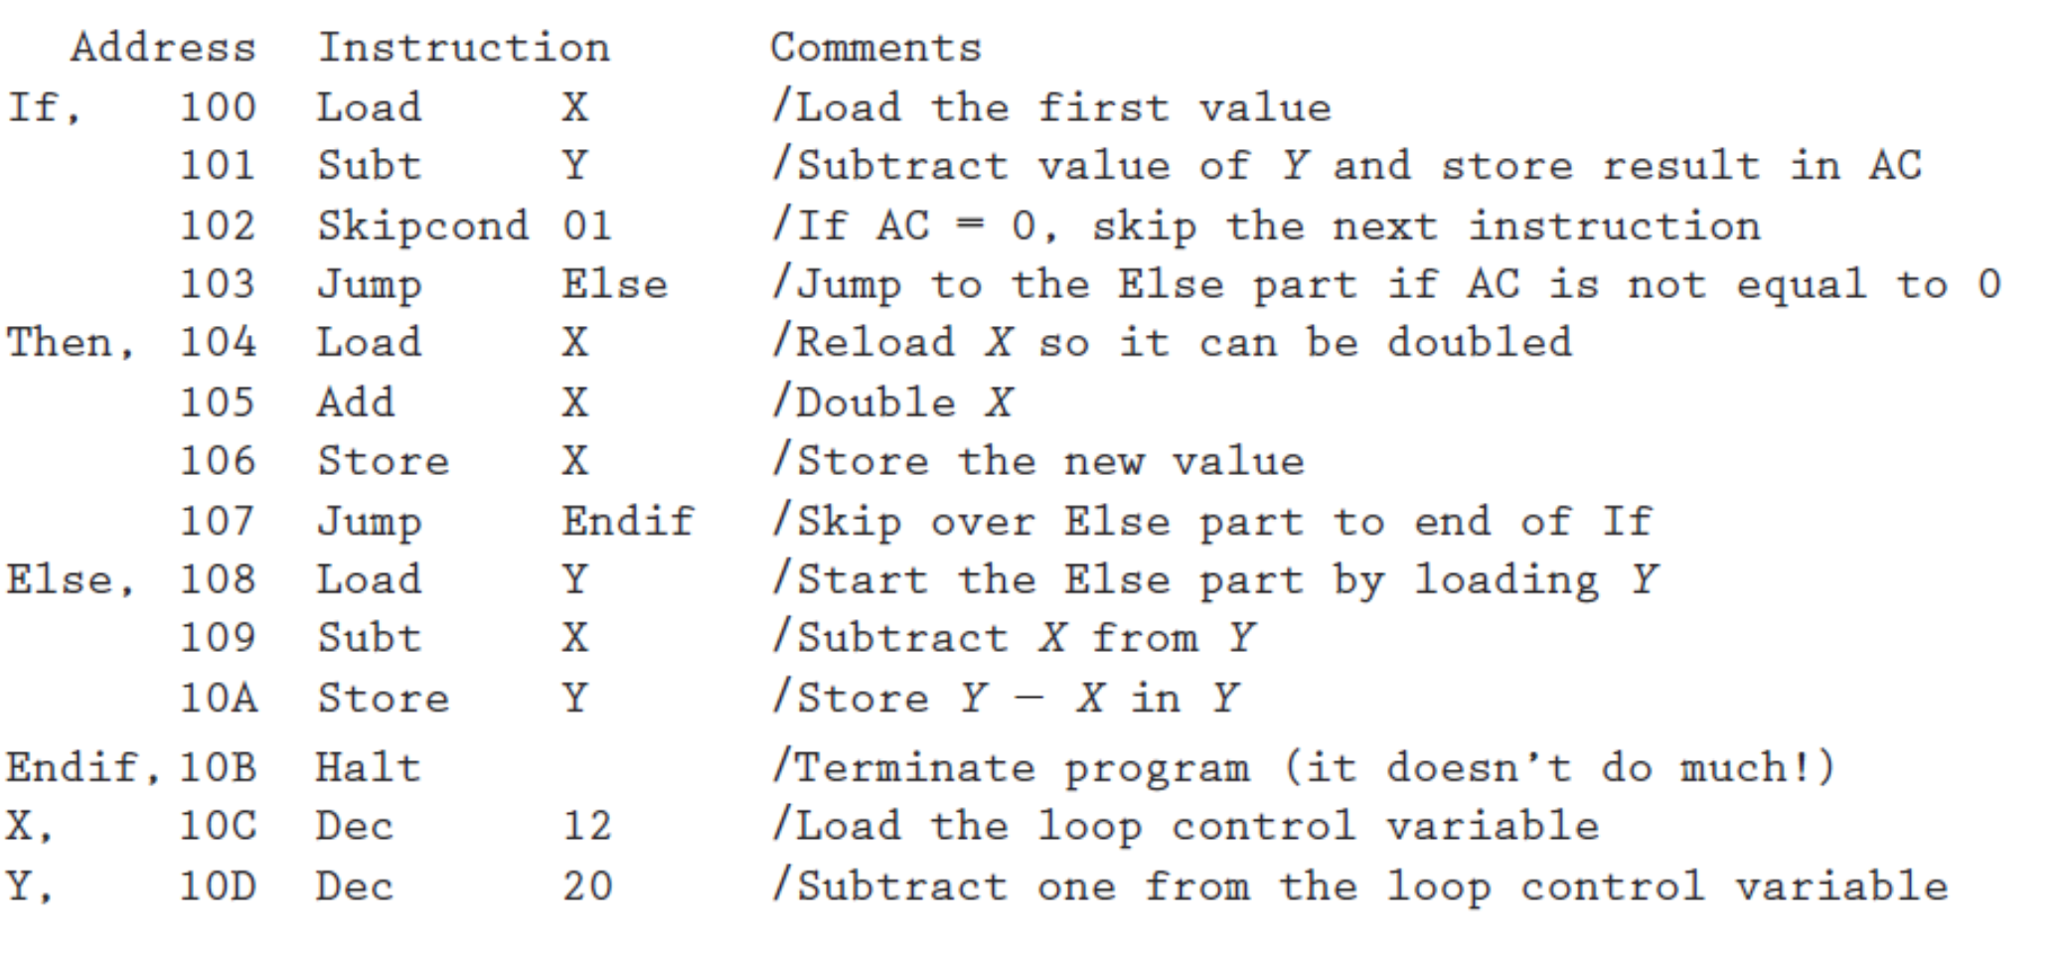

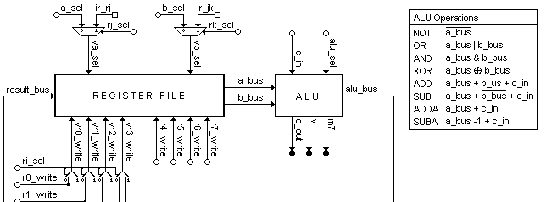
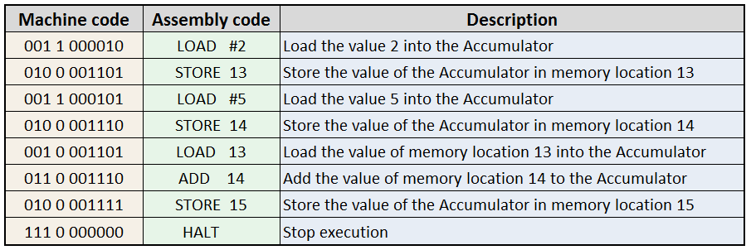
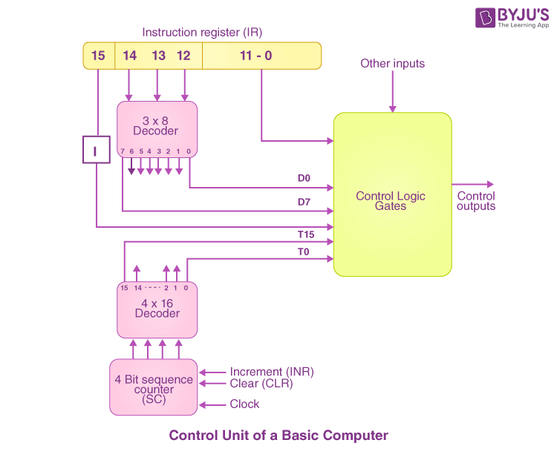
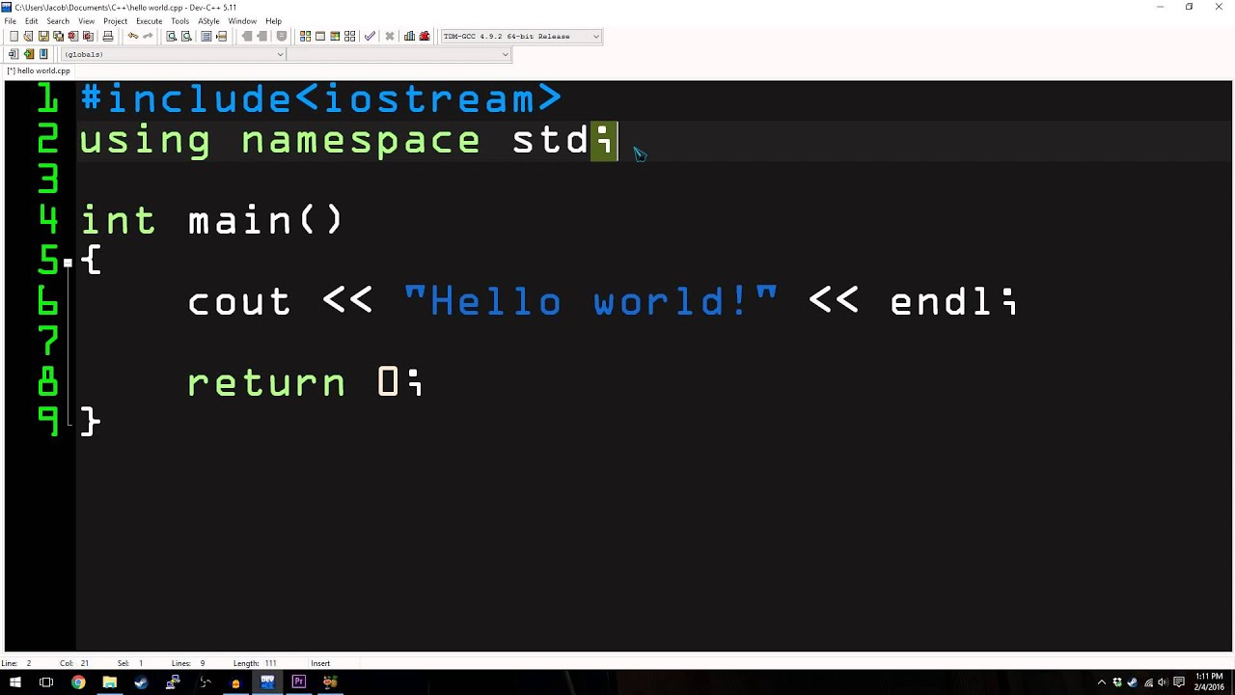
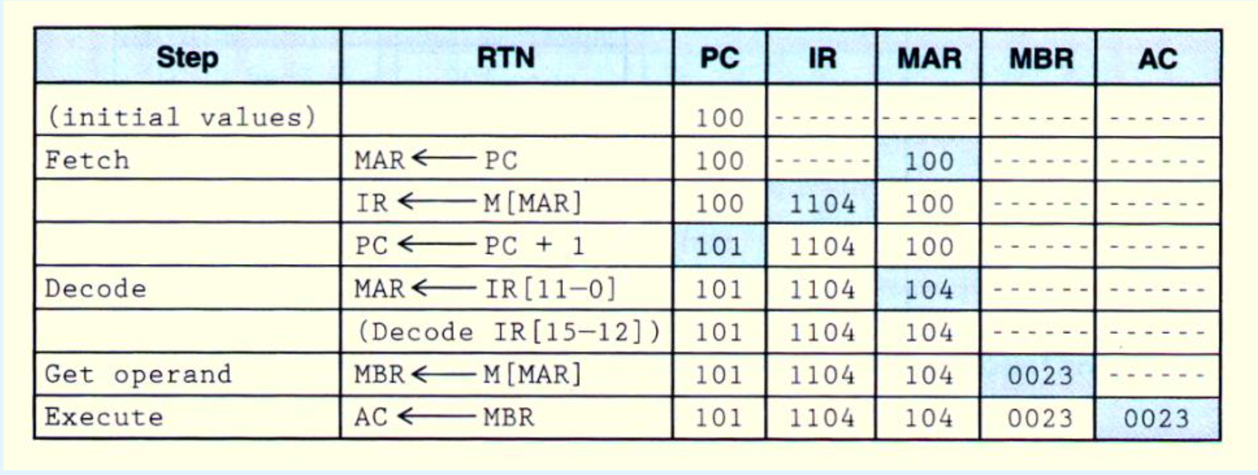
Computer
Bare Metal
Microcode
(Microcode is program consists
of microinstructions)
Microoperations (Micro-ops)
(in RTN, CPU Level)
Instructions
（defined by ISA, Computer Level）
Program
(Algorithm Level)
Software
(Service Level)
Control Signals
(hardwired/microprogrammed)
(Circuit Level)
Machine Codes
Instruction ‘load 104’ in RTN

